Slide 1
E-commerce Database Design Abdullah All Mahfuz 13045456

Slide 2
A simple Blog:
post id userId date type(privarte/public) catagory postBody
user id pw fullname email
reply id reply userId postId commentId replyDate
comment id postId userId commentBody

Slide 3
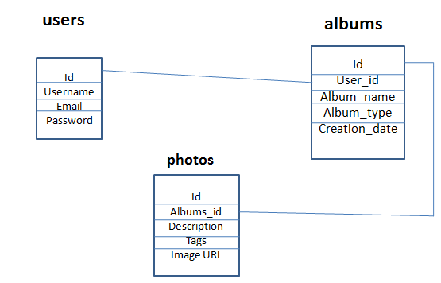
File uploading and Server side file management:

Slide 4
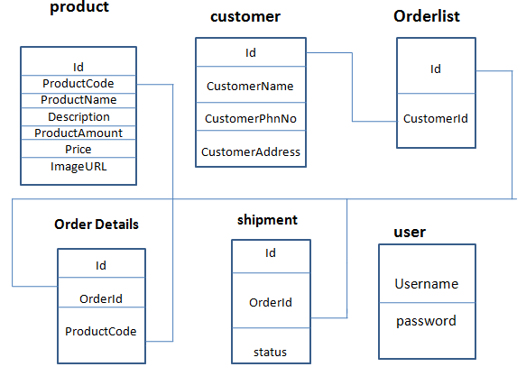
A simple Shopping Cart:

Slide 5
Supplier Oriented B2B – eAuction
users id fullname email password
products Id productName productDescription ProductPhotoUrl ProductStartingBidPrice BiddingStartTime BiddingStartTime
bitDetails id userId productId latestBidding Price

